Slide 1


Lesson 23 Green talk
UNIT 5

Slide 2

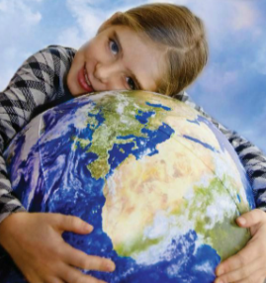

Explain the term green living.
To live green and sustainably is a lifestyle.
It doesn’t do long-term or irreparable damage to the nature.
What are some ways to live more sustainably?
Should everyone live like that? Why?
How do you think we could make our lifestyle more sustainable?
Write down some ideas.

Slide 3
Translate:
miran
peaceful
fresh air
a lot of places to go for a walk / ride your bike
no traffic
living in contact with nature
no shopping facilities
no education facilities
not enough sports facilities
svjež zrak
puno mjesta za šetnju ili vožnju biciklom
nema prometa (prometne gužve)
živjeti u dodiru s prirodom
nema trgovina
nema obrazovnih ustanova
nema dovoljno sportskih objekata

Slide 4
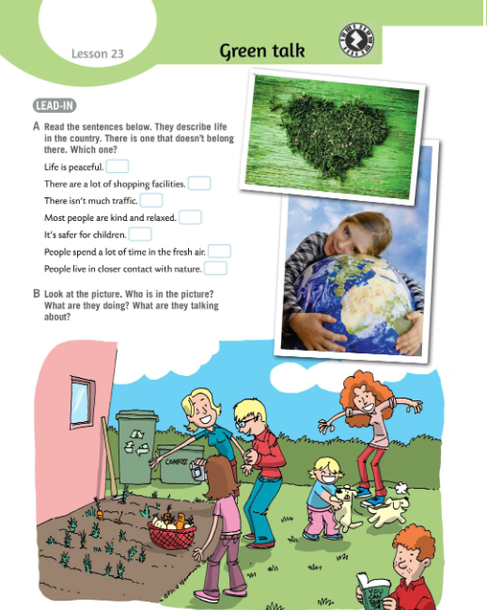
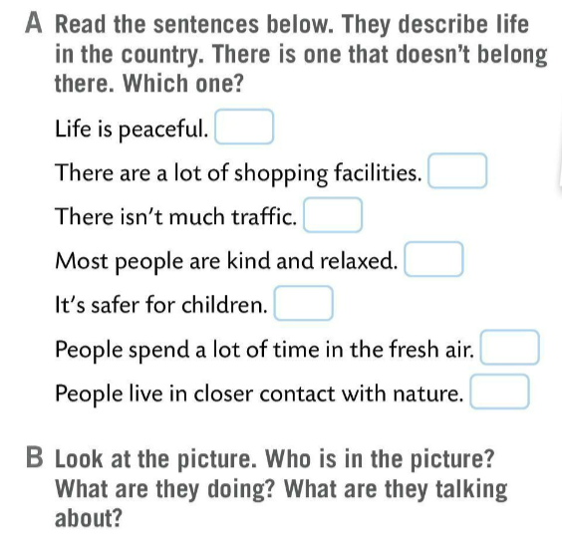
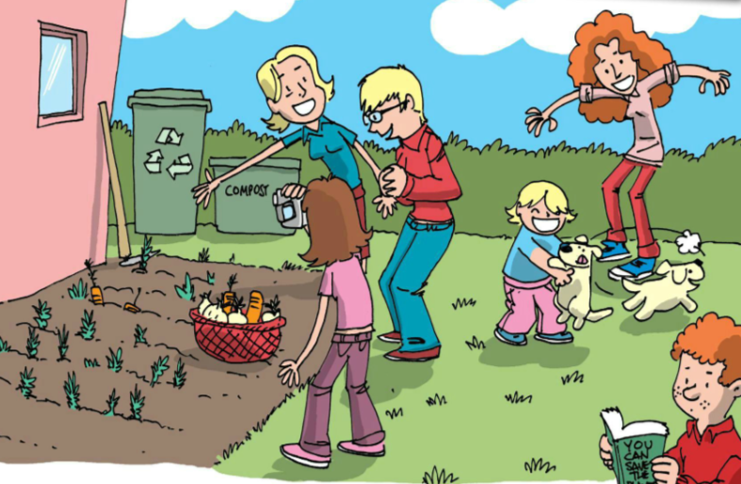
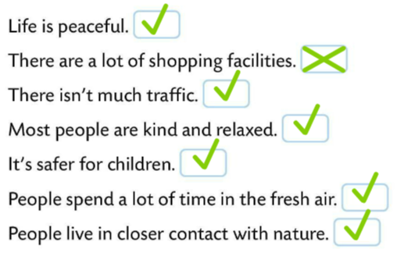
Read the sentences in Task A.
There is one that doesn’t belong there. Which one?
Check.
Look at the picture in Task B.
Who is in the picture? What are they doing? What are they talking about?
Check.
Susan and Jenny are playing with the puppies.
They are called Roley and Poley.
Emma is filming Erica and Ellen.
Erica is showing Ellen their vegetable garden.
In the background there is a container for compost and a container for recycling.

Slide 5
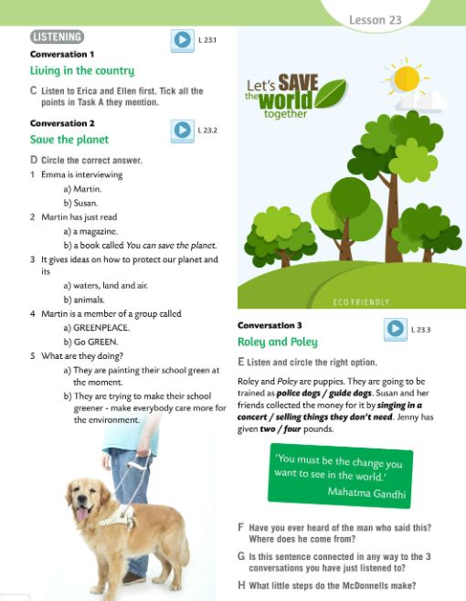
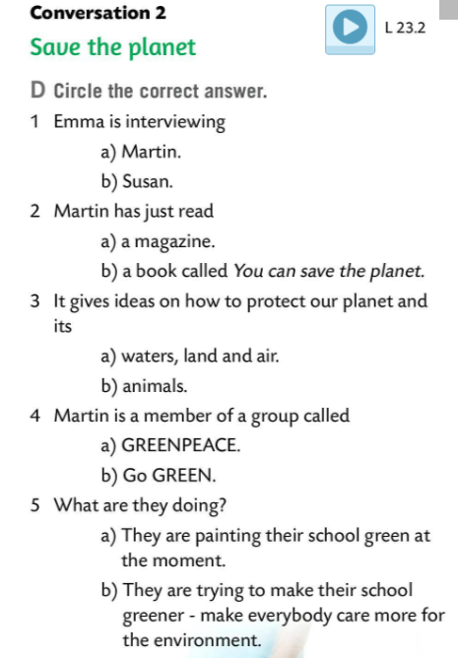


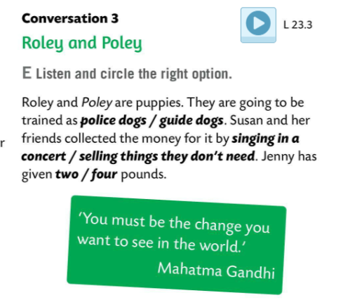
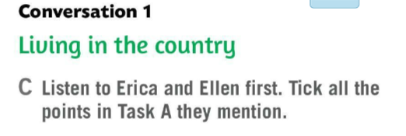
Listen to Erica and Ellen first. Tick all the points in Task A they mention.
Listen to the recording and circle the correct answer in Task D.
Read aloud and check.
Listen to the third conversation and circle the right option in Task E.
Check.

Slide 6
What are good and bad sides of living in the country? What are some good and bad sides of living in the city? Discuss in pairs.
Make a table and write some good (pros) and bad sides (cons) of living in the country.
Find the opposites. Copy in your notebook.
The opposite of…
not much/many/little is… → a lot of
less is… → more
peaceful life is… → a stressful life
less dangerous is… → more dangerous
most people is…. → a few people
relaxed is … → a tense, stressed out person
PROS
CONS

Slide 7
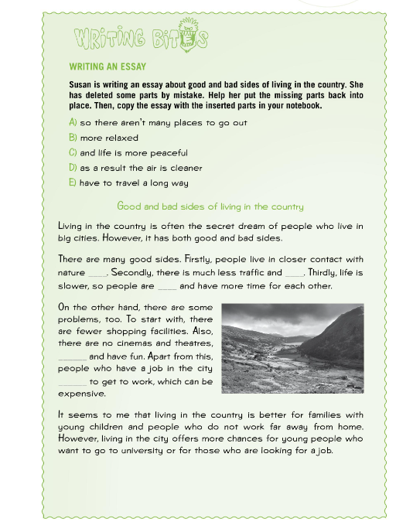

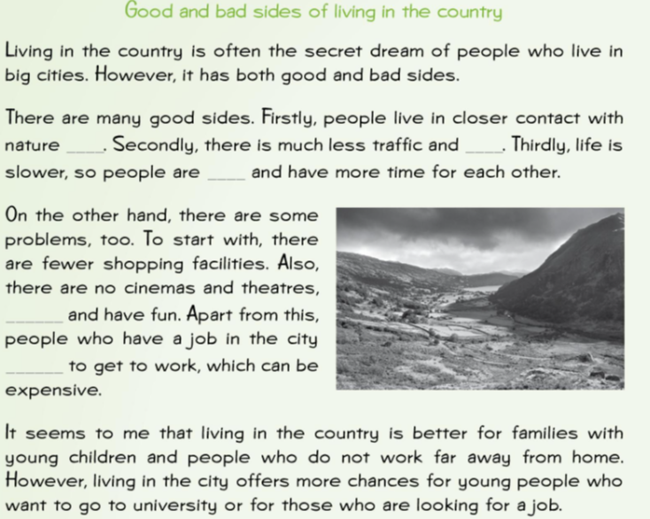
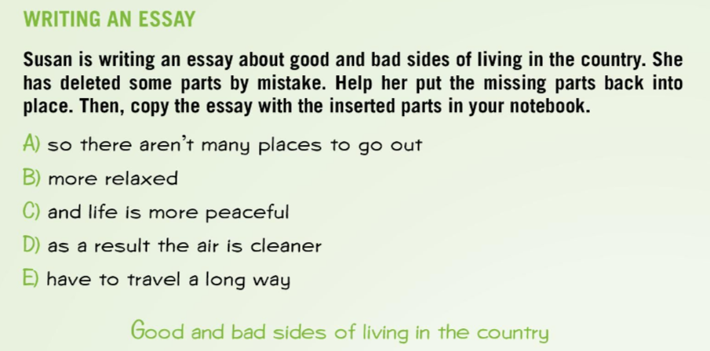
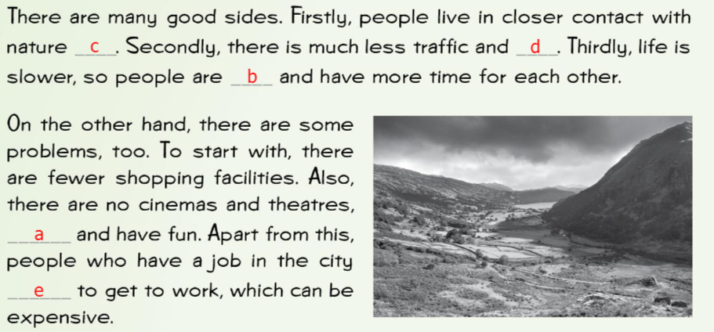
Workbook page 113.
Susan is writing an essay about good and bad sides of living in the country. She has deleted some parts by mistake.
Help her put the missing parts back into place.
Copy the essay.
Check.

Slide 8
Read the quote. Do you agree with it?
Have you ever heard of the author?
Where does he come from? Search for the answers in pairs.
Mahatma Gandhi was the leader of India’s non-violent independence movement against British rule in South Africa. He advocated for the civil rights of Indians.
Is the quote connected in any way to the 3 conversations you have listened to?
What little steps do the McDonnells make?

Slide 9
The McDonnells have got the solar panels installed.
They also recycle and make compost.
Martin likes reading books on ecology.
Martin and his eco group try to make their school greener.
They have made some leaflets with tips on how to save energy.
They planted some trees, raised money for the green projects, they help the blind, organise a jumble sale to raise money…
Be the change you want to see in the world and make your own poster with tips on how to live green.

Slide 10
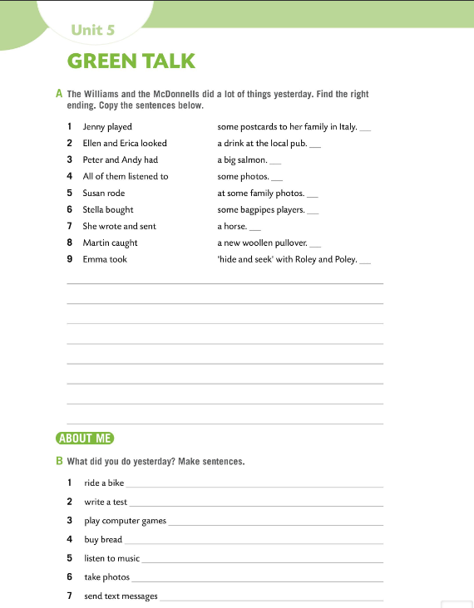
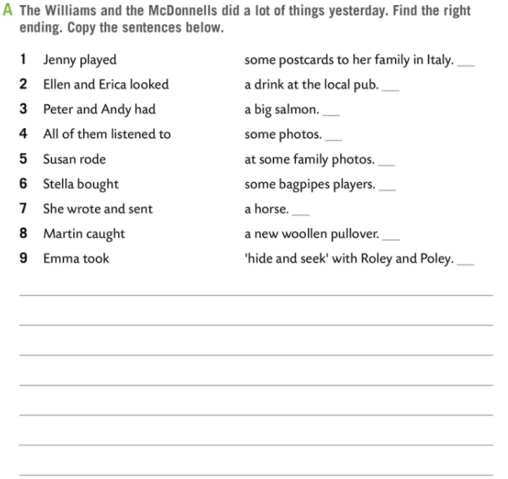
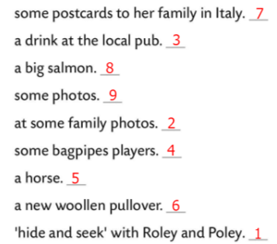
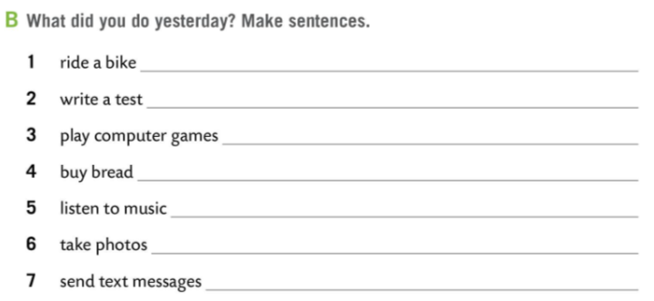
Workbook page 110.
The Williams and the McDonnells did a lot of things yesterday.
Find the right ending. Copy the sentences below in Task A.
Check.
What did you do yesterday?
Make sentences in Task B.
Check in class.

Slide 11
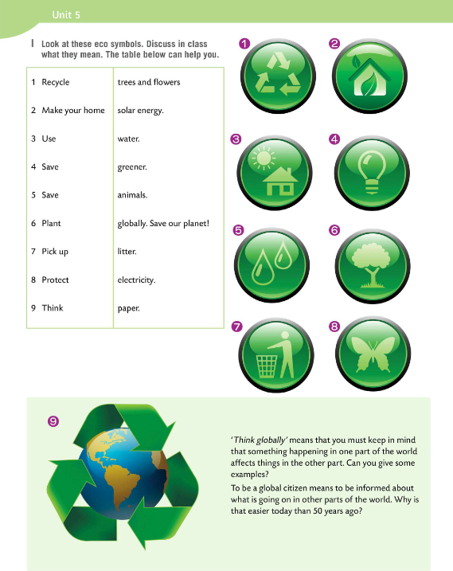
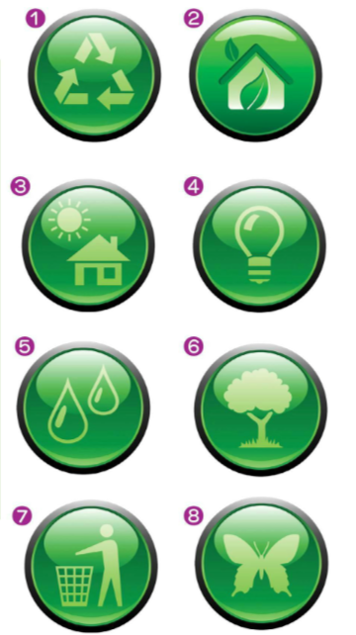
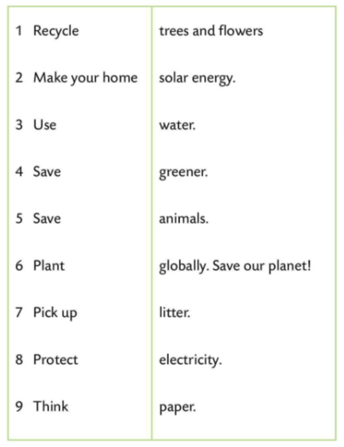
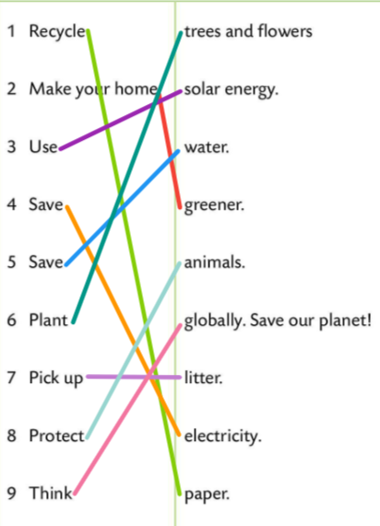
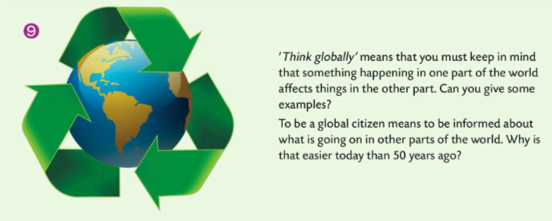
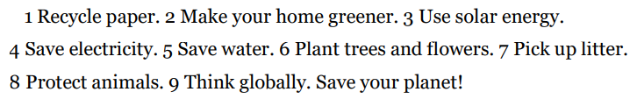
Look at the eco symbols in Task I. Discuss in class what they mean. The table below can help you.
Check.
What does ‘Think globally’ mean?
Read the text and find out.
Translate the phrases from task I.
Work in pairs.

Slide 12
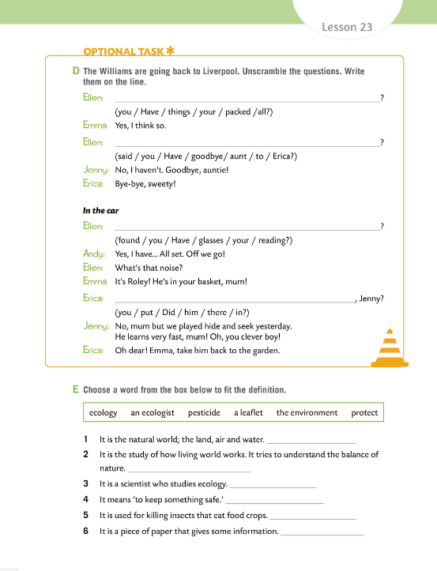
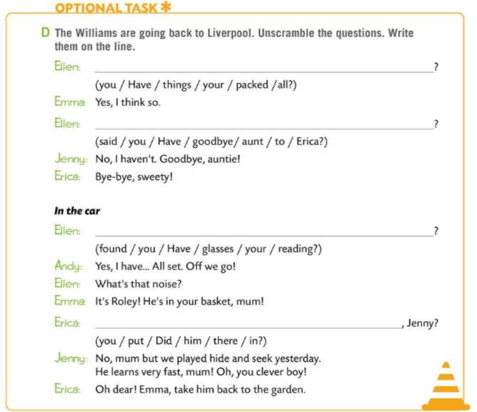
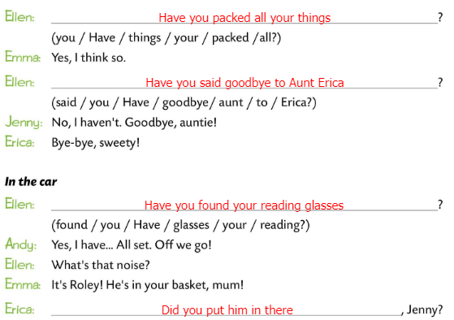
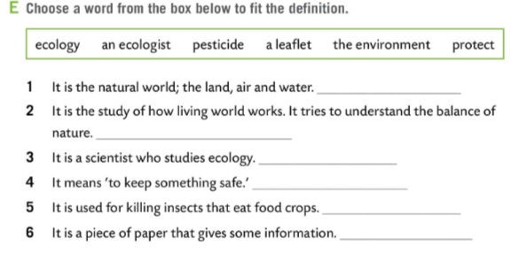
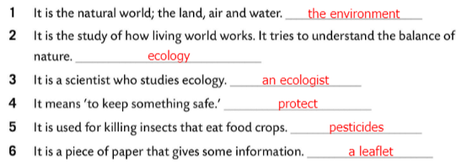
Workbook page 111.
The Williams are going back to Liverpool. Unscramble the questions. Write them on the line in Task D.
Check.
Choose a word from the box in Task E to fit the definition.
Check.

Slide 13
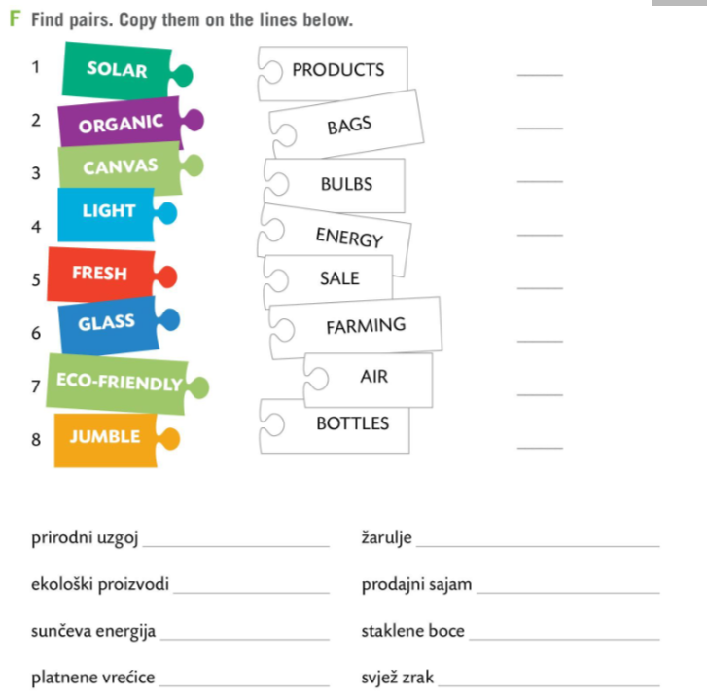
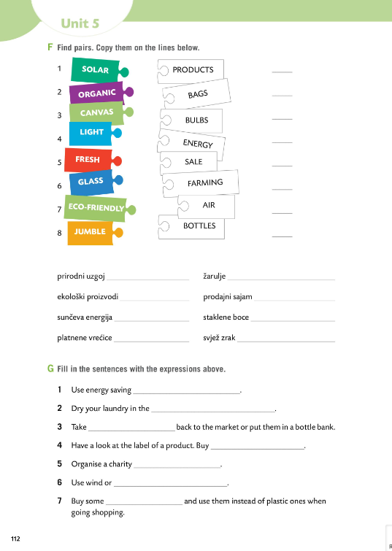

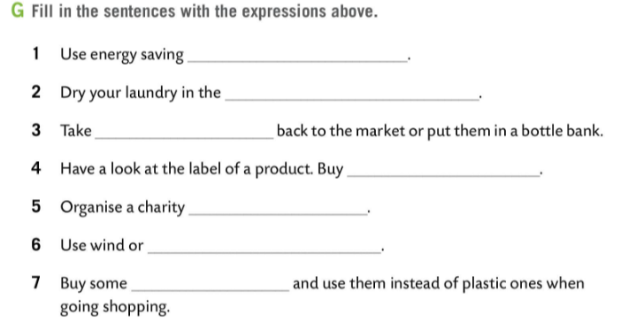
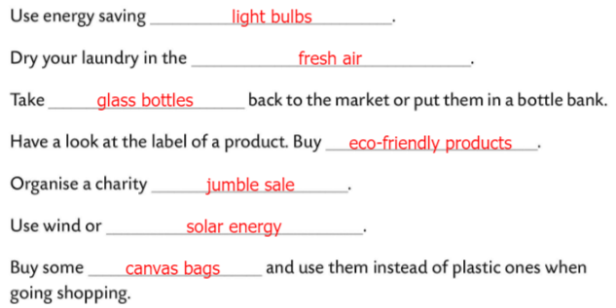
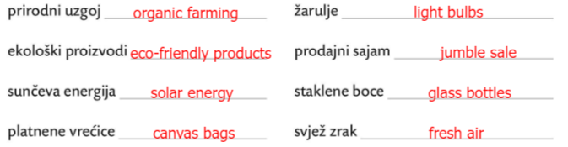
Workbook page 112.
Find pairs in Task F. Copy them on the lines below.
Check.
Fill in the sentences in Task E with the expression from Task F.
Check.

Slide 14
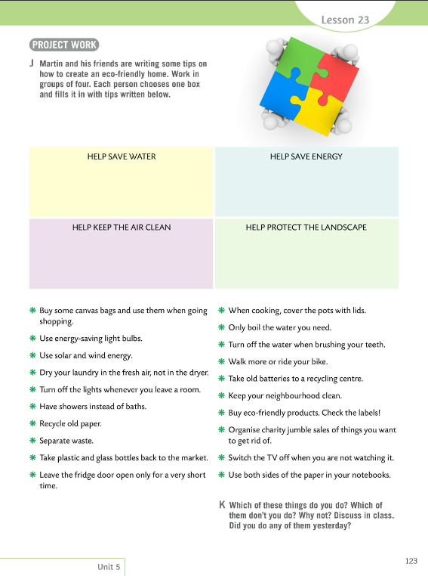
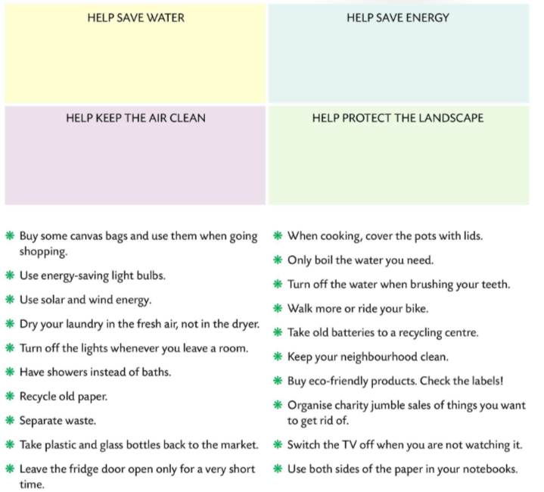
Martin and his friends are writing some tips on how to create an eco-friendly home.
Work in groups of four.
Each person chooses one box and fills it in with tips written below.
Translate the phrases.
Present your work to the class.
Which of these things do you do?
Which of them don’t you do? Why not? Discuss in class.
Did you do any of them yesterday?

